Slide 1

Singapore HDB Resale Price Prediction
Jack @ DreamHome
Notes:
Good morning everyone, my name is Jack Fong. Today, I will be presenting my project about Singapore HDB resale price prediction.

Slide 2
01
03
Introduction
Feature Selection
Conclusion
02
04
Data Wrangling, Exploratory Data Analysis, Feature Engineering
My Agenda
05
Why I did this project?
History
About me
Problem Statement
Target audience
One hot encoding
Correlation heatmap
Pairwise correlation
Low variance
RFECV
Feature importance
Permutation feature importance
Conclusion
Benefits
Limitations
Future works
Modelling
What’s the outcome?
Dataset
New features
What did I find?
Jack @ DreamHome
Notes:
For my today agenda, I would like to walk you through the Introduction, Data Wrangling/EDA/Feature Engineering, feature selection, modelling and finally the conclusion

Slide 3
Introduction
Jack @ DreamHome

Slide 4
Why This Topic Interests Me?
Introduction
I want to buy a resale HDB flat,
Not entitle to buy the BTO flat,
Looking for the HDB that fit my requirements,
Buyers that are sick of waiting for the BTO flat and not getting the place or unit that satisfy them.
Jack @ DreamHome
Notes:
Why this topic interests me?
1. I am interested to get a HDB flat. I believe most of you want the same thing as well.
2. I am not entitling to buy the BTO flat,
3. I am looking for the HDB flat that fit my requirement.
4. There are other buyers that are sick of waiting for the BTO flat and not getting the place or unit that satisfy them.

Slide 5
History of the HDB
Introduction
1961
1927
First HDB flats completed, located at Stirling Road, Queenstown.
Singapore Improvement Trust (SIT) has establisehd to build public housing.
NOW
1960
1971
HDB set up with it taking over from the SIT to solve the housing crises.
HDB resale market has set up to allow people to sell their HDB flats.
Jack @ DreamHome
Notes:
This slide will show you a history of the HDB.
In 1927, SIT has established to build public housing.
But in 1960, there was a housing crisis in Singapore. Many people were living in unhygienic slums. Only 9% of Singaporeans lived in government flats. The HDB was thus set up in February 1960, tasked to solve this issue by building the HDB Flat.
In 1961, the first HDB flats have completed. In less than 5 years, HDB had built 76,000 HDB flats. Within 10 years, HDB had built a sufficient number of flats for Singaporean and resolved the housing crisis.
In 1971 HDB resale market has set up to allow people to sell their HDB.
Today, Singapore’s HDB programme is recognised as one of the best public housing programmes globally and home to approximately 80% of the resident population.

Slide 6
About Myself Freelance data scientist who is enthusiastic about the growing resale HDB market in Singapore.
Introduction
Problem Statement
How might I be able to build a price prediction tool to better predict the HDB resale price.
DreamHOME
Target Audience
Resale HDB buyer
HDB owner
Real Estate agent/agencies
Jack @ DreamHome
Notes:
I am a freelance data scientist who is enthusiastic about the growing resale HDB market in Singapore.
My problem statement is how might I be able to use a regression machine learning model to build a price prediction tool to better predict the HDB resale price for those using the tool.
My target audiences are the resale HDB buyer, HDB owner and real estate agent/agencies.

Slide 7
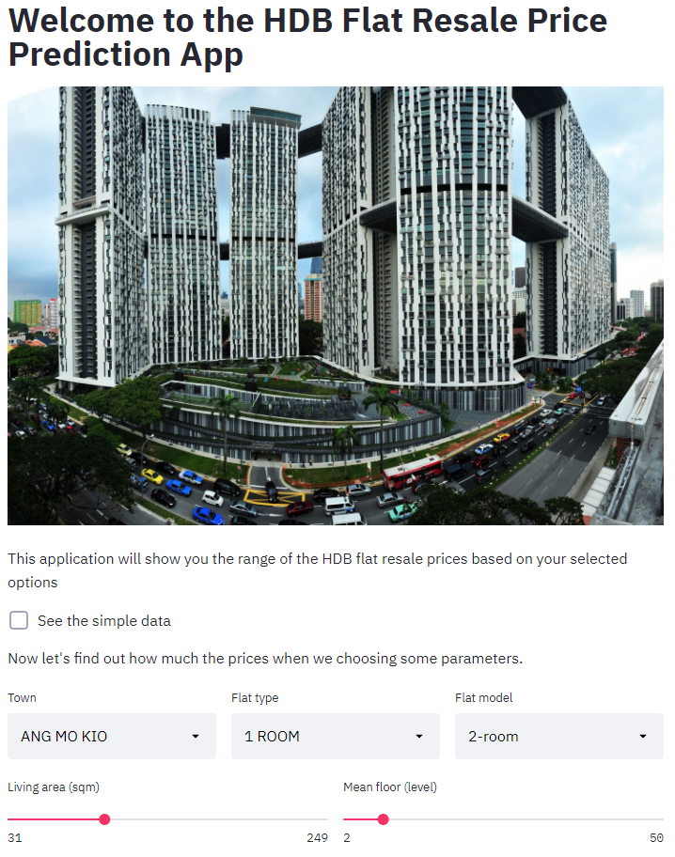
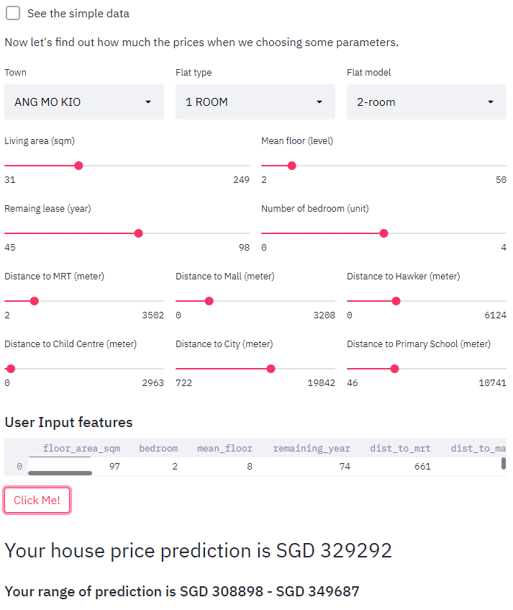
My Resale HDB Prediction Website
Introduction
Jack @ DreamHome
Notes:
I am happy to present you the web application that I have created which I will show you later.
Now I will walk you through how we got here.

Slide 8
Data Wrangling, Exploratory Data Analysis, Feature Engineering
Jack @ DreamHome

Slide 9
Overview of the Dataset
Data Wrangling & Exploratory Data Analysis
Data sources from data.gov.sg website,
Consists of around 82,000 data points and 11 features,
Collected from January 2017 to October 2020,
Features list:
Month 7. Floor area
Town 8. Flat model
Flat type 9. Lease commence date
Block 10. Remaining lease
Street name 11. Resale price (target variable)
Storey range
Jack @ DreamHome
Notes:
The dataset is downloaded from data.gov.sg website. It consists of around 82 thousand data points and 11 features that collected from Jan 2017 till Oct 2020. It is about the flat description, location and date related information. The target variable is the resale price.

Slide 10

Anymore features to be considered?
Data Wrangling & Exploratory Data Analysis
Jack @ DreamHome
Notes:
This dataset only has 10 predictors. So, I did research and feature engineering to add new features that might able to improve the prediction.
Steve Martin

Slide 11
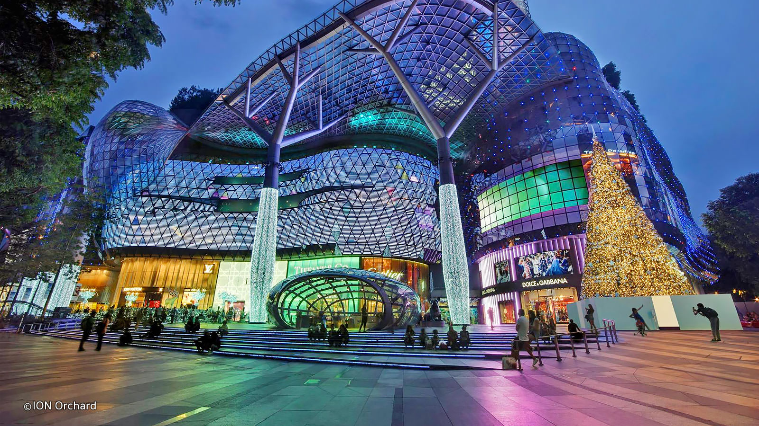





Data Wrangling & Exploratory Data Analysis
Features Added - Distance to Facilities/ Amenities
Jack @ DreamHome
Notes:
The new features that I have added are about the distance to various facilities and amenities using haversine formula.
Hawker center that we can grab our meal, mrt station to take the rail network, shopping mall, a one stop destination for everything, CBD area, kindergarten/childcare center/pre-school for the busy parents and primary school.

Slide 12
More Features to include?
Data Wrangling & Exploratory Data Analysis
Number of bedroom(s)
Number of bathroom(s)
Jack @ DreamHome
Notes:
I have also included the number of bedroom and bathroom into the features list.

Slide 13
Completed Features List
Data Wrangling & Exploratory Data Analysis
Month 10. Distance to MRT
Year 11. Distance to shopping mall
Town 12. Distance to hawker centre
Flat type 13. Distance to childcare centre
Floor area 14. Distance to city
Flat model 15. Distance to primary school
Lease commence date 16. Bedroom
Mean floor 17. Bathroom
Remaining year 18. Resale price (target variable)
Jack @ DreamHome
Notes:
Now, I have 17 predictors. Next, I have selected 4 features to look at the relationship between the predicted variables with the target variable.

Slide 14
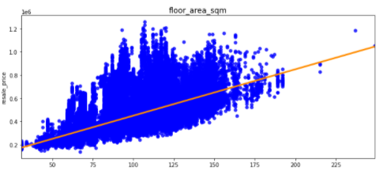
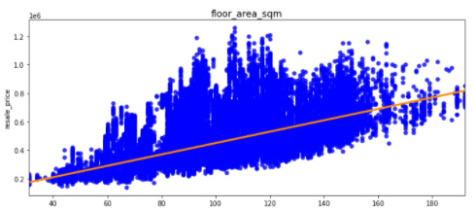
1. Numeric Feature: Floor Area
Data Wrangling & Exploratory Data Analysis
There are some outliers identified.
Outliers
Floor area increase, the resale price increase.
Jack @ DreamHome
Notes:
This scatter plot shows the relationship between the floor area versus the resale price. What could we interpret from this plot.
You can see that there are some outliers that lie an abnormal distance from other data which will be removed later. Outliers can have a disproportionate effect on statistical results which can result in misleading interpretations
The orange diagonal line tell us that the floor area has the positive relationship with the resale price, which mean the increase of the floor area will lead to higher resale price.

Slide 15
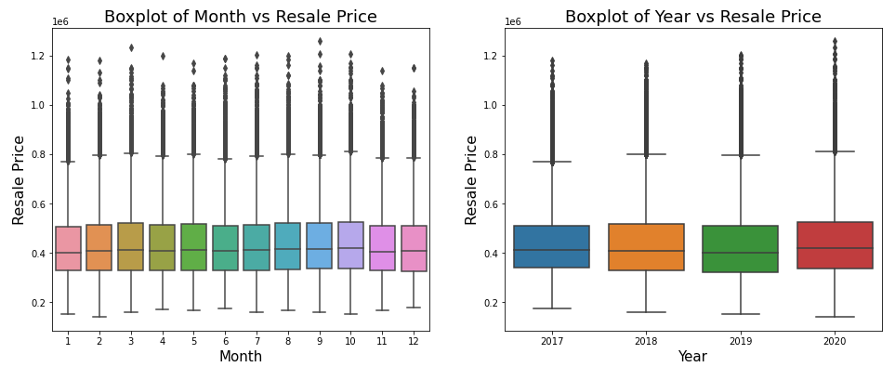
2. Numeric Feature: Month & Year
Data Wrangling & Exploratory Data Analysis
The median resale price of the subset of these features are lie around $400,000, they are not useful for prediction.
Jack @ DreamHome
Notes:
This is the boxplot of month and year features versus resale price, you can see that the median resale price of the subset are almost similar, which mean the subsets is likely to have very similar variances, thus, it is not useful for the prediction.

Slide 16
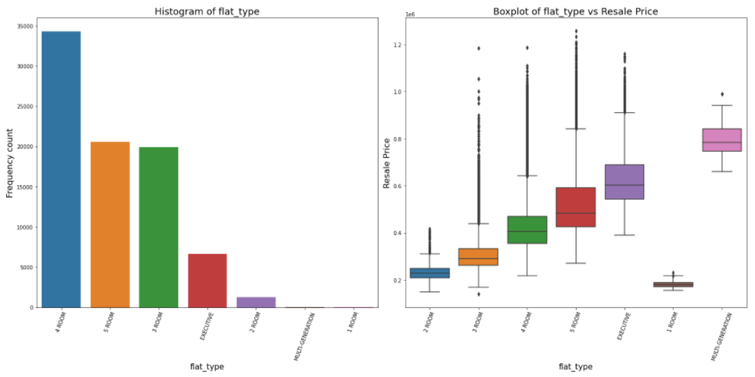
3. Categorical Feature: Flat Type
Data Wrangling & Exploratory Data Analysis
Different median resale price for the subset.
Jack @ DreamHome
Notes:
This is flat type versus resale price. As you can see from the box plot, the median resale price of the sub-features has a huge difference between each other, this feature will have an effect on the resale price.

Slide 17
Feature Selection
Jack @ DreamHome
Notes:
Next, I will tell you how I perform the feature selection.

Slide 18
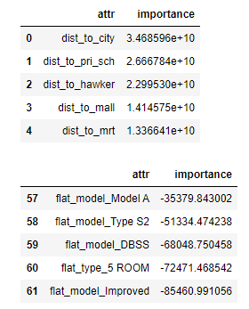
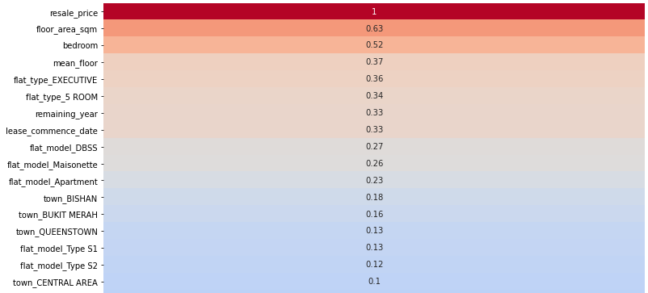
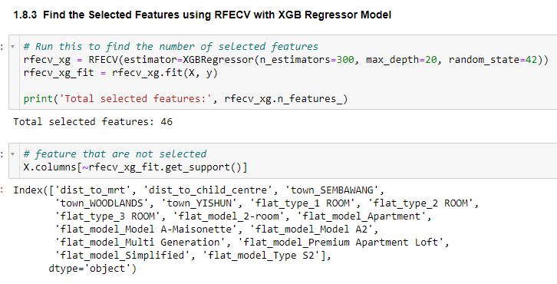
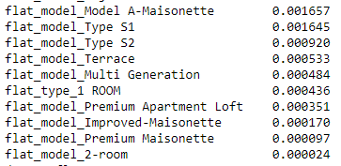
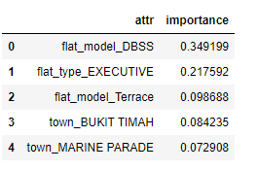
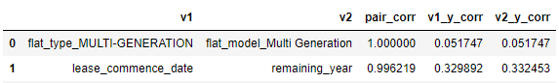
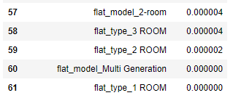
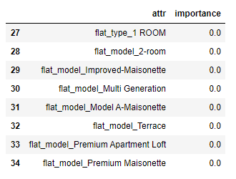
Feature Selection
Recursive Feature Elimination with Cross-Validation
RFECV
Pairwise Correlation - all features
Permutation Feature Importance
One hot encode - categorical features
Method 1
Method 3
Method 5
Method 2
Method 4
Method 6
Correlation heatmap of resale price with all features
Low Variance
CART and Boosted Feature Importance
Jack @ DreamHome
Notes:
I have used 6 methods for feature selection. I will first convert the categorical variables into binary variable using one hot encoding.
Method 1 Correlation heatmap will tell the correlation between the predictors with the target variable.
Method 2 Pairwise correlation is to identify two features that carry similar information.
Method 3 low variance is to identify the features with near to zero variance due to less predictive power.
Method 4 RFECV will automatically select the number of features that are useful for prediction.
Method 5 CART and Boosted feature importance will assign a score to the predictors based on how useful they are at predicting the target variable.
Method 6 Permutation feature importance breaks the relationship between predictors and the target variable, the drop in the model score is indicative of how much the model depends on the predictors.
After going through all these methods, I have shortlisted the features list from 65 features to 49 features.

Slide 19
Modelling
Jack @ DreamHome
Notes:
Next, is about the modelling.

Slide 20
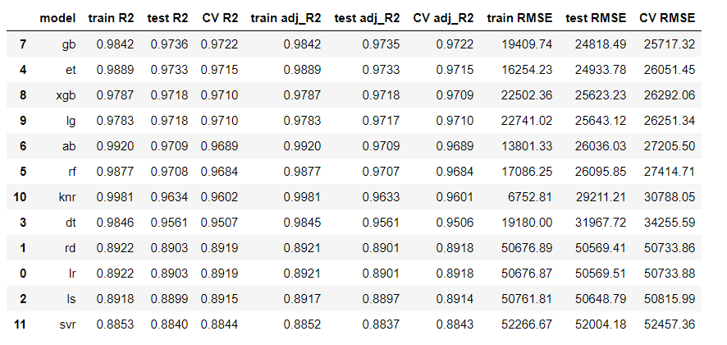
Regression Model Results
Acronym:
Gb - GradientBoostingRegressor
Et - ExtraTreesRegressor
Xgb - XGBRegressor
Lg - LGBMRegressor
Ab - AdaBoostRegressor
rf - RandomForestRegressor
Knr - KNeighborsRegressor
Dt - DecisionTreeRegressor
Rd - Ridge
Lr - LinearRegression
Ls - Lasso
Svr - SupportVectorRegression
Gradient Boosting Regressor model seems to be the best model because of the lowest test root mean squared error (RMSE).
Jack @ DreamHome
Notes:
I have tried 12 different regression machine learning models and I have chosen the gradient boosting regressor as my best model because it returns the lowest test RMSE result. The model is still slight overfit because the increases of RMSE from 19 thousand of the train set to 24 thousand of the test set. RMSE measure of the difference between values predicted by the model and their actual values. Lower values of RMSE indicate better fit.
Just a brief introduction of how’s the Gradient boosting works. Gradient boosting relies on the intuition that the best possible next model, when combined with previous models, minimizes the overall prediction error. The key idea is to set the target outcomes for this next model in order to minimize the error.

Slide 21
Conclusion
Jack @ DreamHome

Slide 22
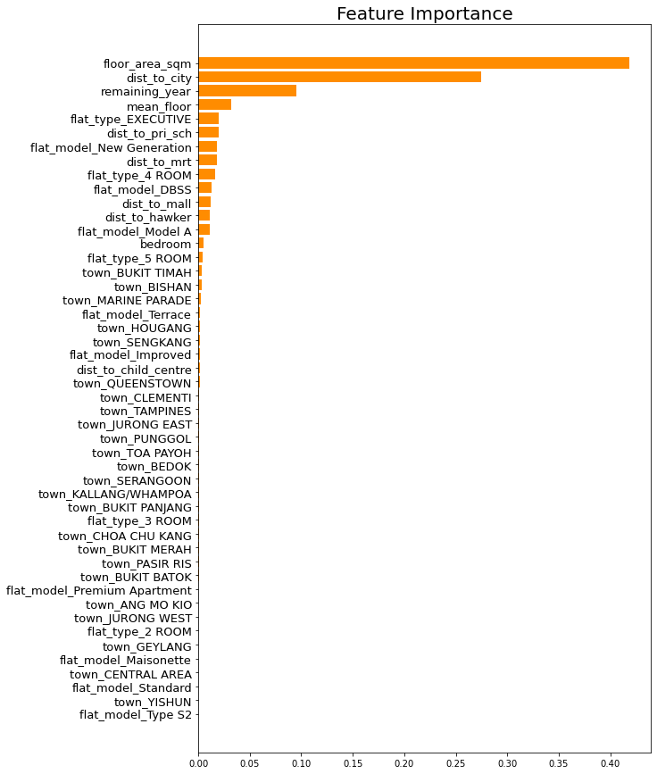
Conclusion
Conclusion
Gradient Boosting Regressor has achieved satisfactory results: RMSE - $17,815 when I train the complete dataset and solve my problem statement
* Recall Problem Statement : How might I be able to build a price prediction tool to better predict the HDB resale price.
Top 5 features: Floor area, distance to city, remaining year, mean floor and distance to primary school.
Jack @ DreamHome
Notes:
I am glad that Gradient Boosting Regressor has achieved a satisfactory result with the RMSE of around $18 thousand dollar and resolved my problem statement.
The top 5 features that impact the resale price have been identified. They are floor area….
1. floor_area_sqm – it is obvious that the bigger the space, the greater the price of the HDB flat,
2. dist_to_city – the nearer to the city, you will able to access to the better amenities and facilities,
3. remaining_year – the longer the lease, you will able to apply for larger loan from the HDB or banks and the condition of the HDB flat would be relatively better,
4. mean_floor – the higher floor, you will have better view, cooler, less noise, less mosquitoes etc,
5. dist_to_pri_sch – Singapore citizen who live within 1km of the school will be given priority to get into the primary school. Most of the Singaporean families will tend stay near to the top primary school so that their children will have better education.

Slide 23
Benefits
Conclusion
The predictive price is presented as a range e.g., if the predicted price is $450,000, it will show the range between $430,000 to $470,000
Buyer and seller can DIY and save the agent fee.
Can be used equally by buyer, seller, property agents or agencies and others.
Limitations
This model is only able to predict the resale price for the nominated features.
This model is not applicable for other property price prediction.
Jack @ DreamHome
Notes:
The benefits of the model are
The predictive price is presented as a range e.g., if the predicted price is $450,000, it will show the range between $430,000 to $470,000,
Buyer and seller can DIY, buy and sell the HDB without approaching the agent.
Can be used equally by buyer, seller, property agents or agencies and others.
Too bad this model also has its limitations:
It’s only able to predict the price for the nominated features, but the user is not able to enter the target price and then receive available HDB resale flats for that price and the associated features,
It is not applicable for other property price prediction,

Slide 24
Future Work
Conclusion
Additional features such as flat condition rating, GDP and population density of the HDB estates,
Scrape more data from the different resources such as PropertyGuru or 99.co website,
Retrain the model as and when new data added,
Train a new model if new feature/s added,
Tuning the hyperparameters of the machine learning model.
Jack @ DreamHome
Notes:
For the future work, I have listed 5 ideas to improve the model:
Additional features such as flat condition rating, GDP and population density of the HDB estates,
Scrape more data from the different resources such as PropertyGuru or 99.co website,
Retrain the model as and when new data added,
Train a new model if new feature/s added,
Tuning the hyperparameters of the machine learning model.

Slide 25
My Resale HDB Prediction Website
Conclusion
Jack @ DreamHome
Notes:
Now, I would like to show you how my website performs the real-life prediction. All you need to do is select all this options then you will get the price prediction.
If anyone of you interested to get the resale HDB, you may approach me later. ☺

Slide 26
Thank you
Any questions?
Jack @ DreamHome

Slide 27
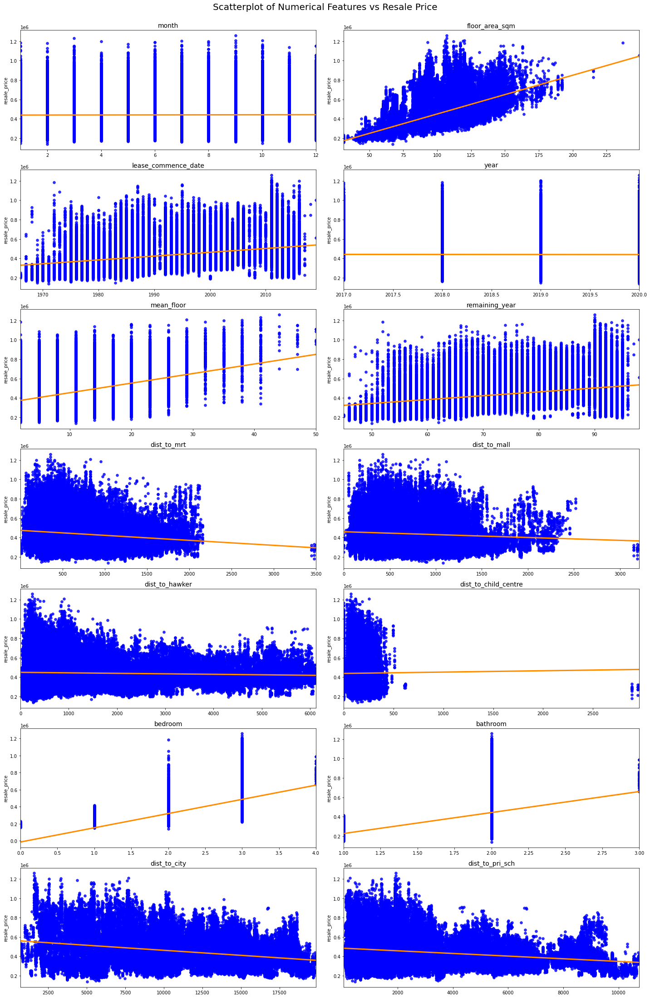
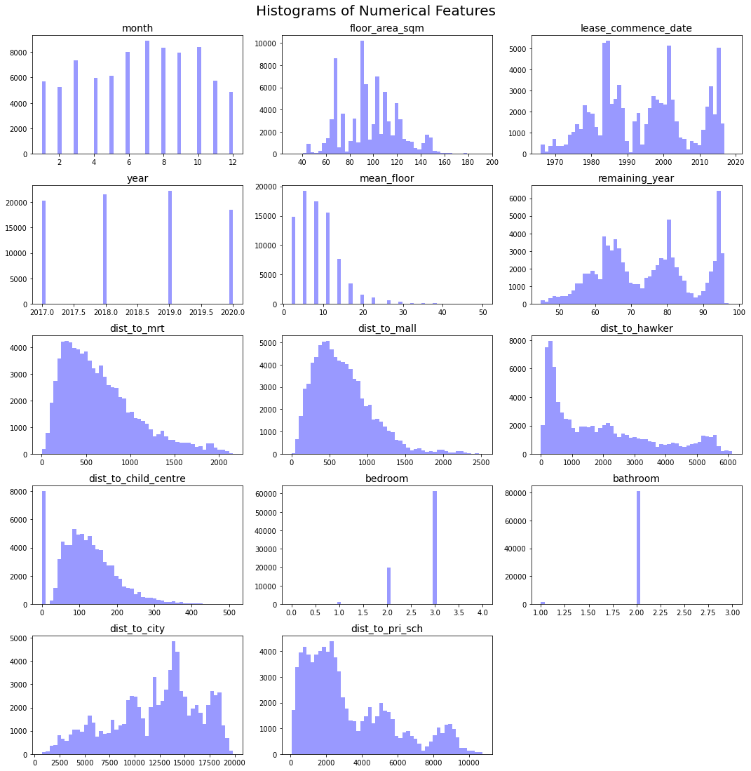
Numerical Variables vs Resale Price
Data Wrangling & Exploratory Data Analysis
Notes:
On our left side are the scatter plots that shows the relationship between the numerical variables versus resale price. I will be using these plots to identify the outliers and how’s the numerical variable react to the target variable.
On the right side are the histograms that show the frequency count of the sub-features of each features. I will be using this plot to identify the feature that have the heavily over-presented sub feature.

Slide 28
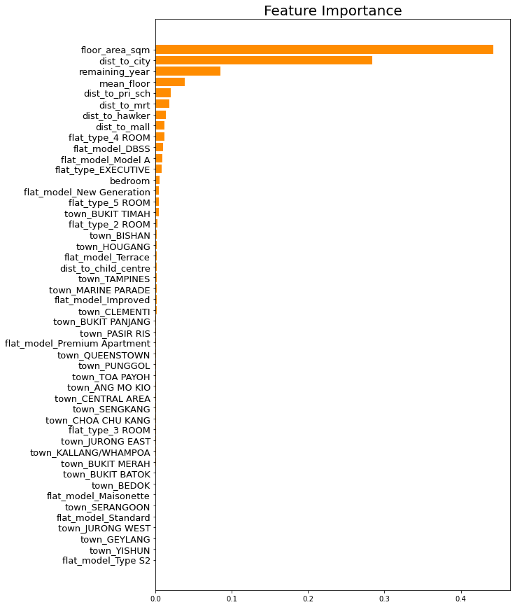
Feature Importance List

